Slide 1

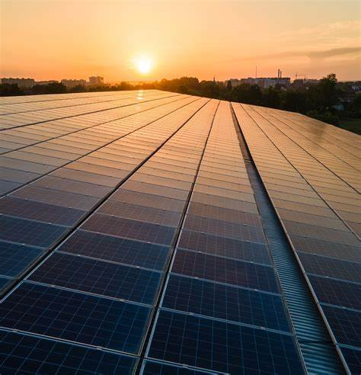

machine learning
SOLAR PANEL
PREDICTION
Presented by: Ali hayek

Slide 2





ABOUT THE PROJECT
BUSINESS PROPOSAL
BUSINESS PLAN
This project aims to develop a machine learning-based system to analyze weather data and predict energy production. By understanding the relationship between weather conditions and energy output
The project underscores the potential of data-driven approaches in addressing
energy challenges

Slide 3





OPJECTIVE
Develop a system to predict energy production based on weather conditions using machine learning.
01
Methods:
Utilized Python libraries (pandas, numpy, scikit-learn, meteostat).
Models: Linear Regression, Decision Trees, Random Forest, Voting Regressor, and Stacking Regressor.
02
Key Findings:
Voting Regressor achieved the highest accuracy.
03
Significance:
Supports renewable energy forecasting and grid management.

Slide 4

WORK FLOW
01
02
03
Load and Prepare Data
Visualization
sampling the data
04
05
06
Train Models
Tune the hyperparameters
Export Results

Slide 5

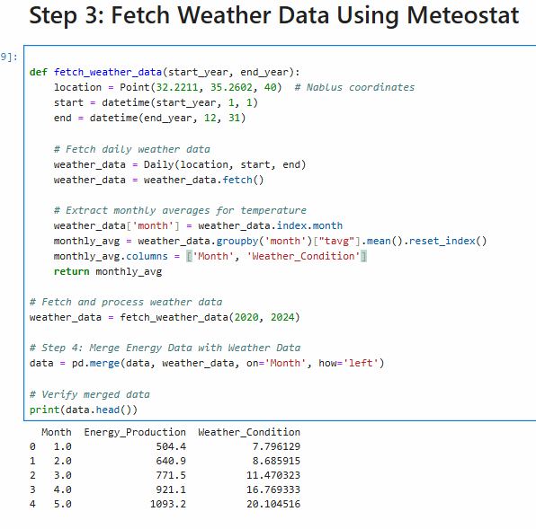
Load and Prepare Data
load the data for five years from SMA app and but it in data frame
handel the missing data if needed
Fetch Weather Data Using Meteostat then Extract monthly averages and marge it with the data frame

Slide 6
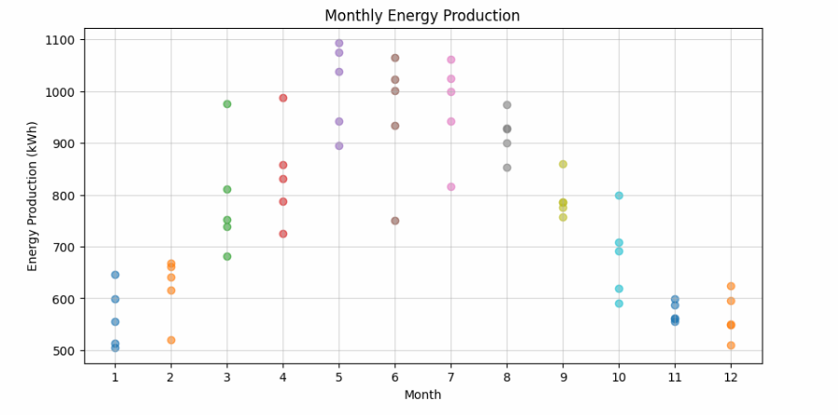
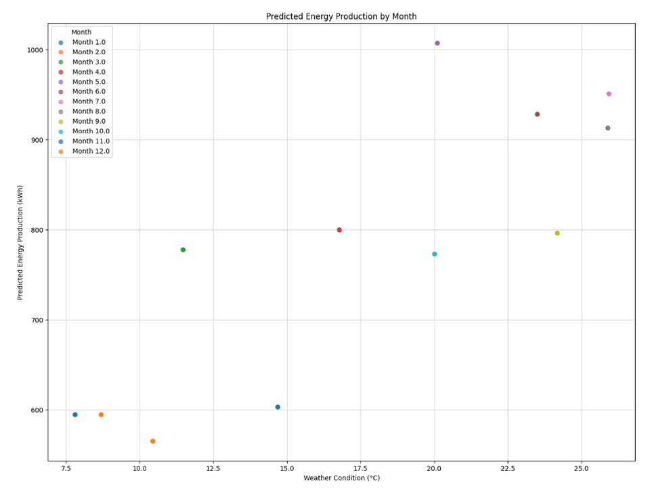
Visualization
To understand the underlying trends and correlations in the data, identify patterns, and ensure data quality.
make sure there are a relationships between the data
Use visual tools (e.g., scatter plots, bar charts) to explore relationships between variables
Monthly visualizations of energy production.

Slide 7
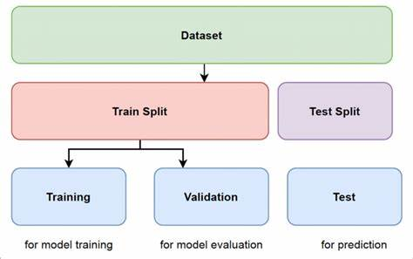
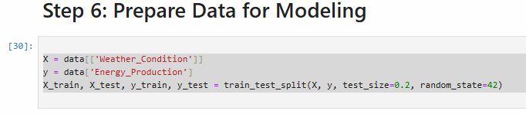
sampling the data
To create separate datasets for model training and evaluation, ensuring that the model is tested on unseen data.
Split the dataset into training and testing sets using a method like train_test_split.
Define proportions for training and testing data (e.g., 80% training, 20% testing).
o

Slide 8
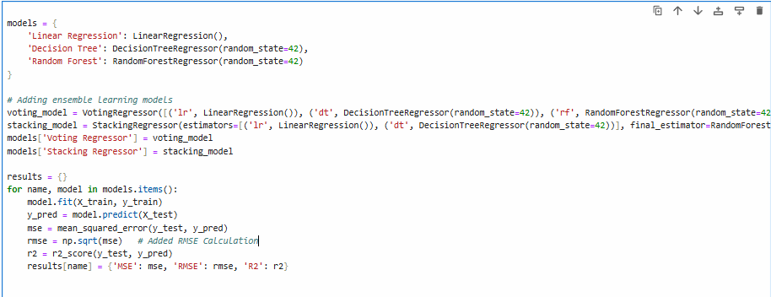
Train Models
To identify the most effective model for predicting energy production based on weather conditions.
Train multiple models such as
Linear Regression
Decision Tree Regressor
Random Forest Regressor
Ensemble models (e.g., Voting and Stacking Regressors).
Evaluate models using metrics like RMSE (Root Mean Squared Error), and R² score.

Slide 9
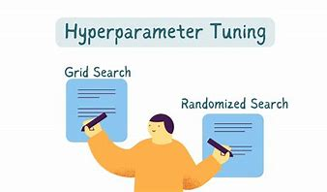
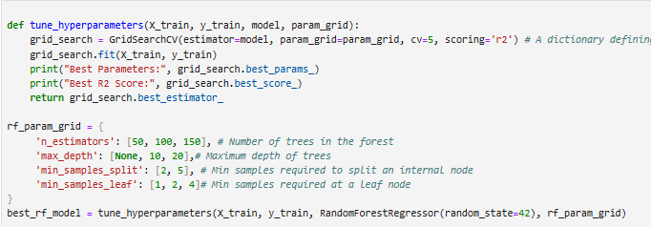

hyperparameters tuning
To refine the model for better performance and demonstrate its improvements with clear visuals.
Tune the best-performing model's hyperparameters (e.g., using GridSearchCV for Random Forest).
Compare the predictions of the tuned model to the initial model.

Slide 10
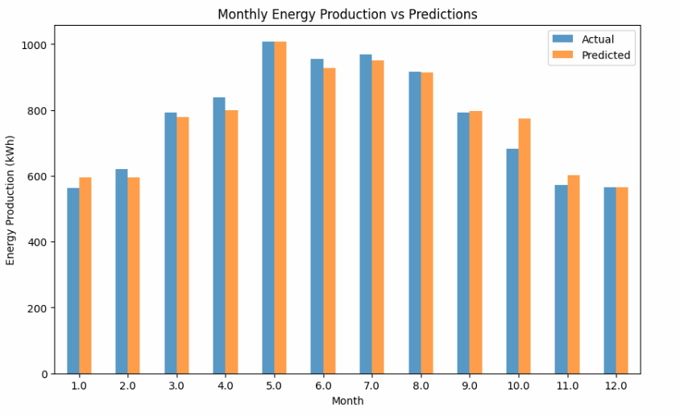
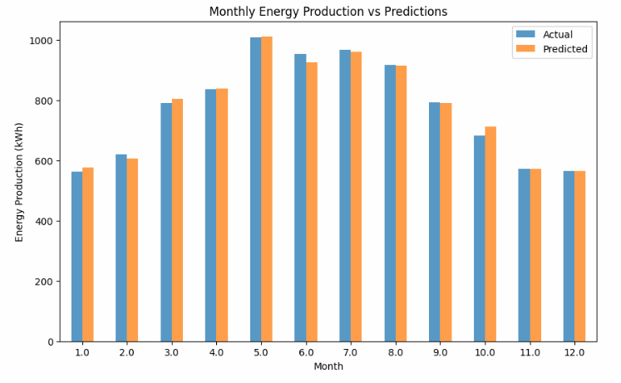
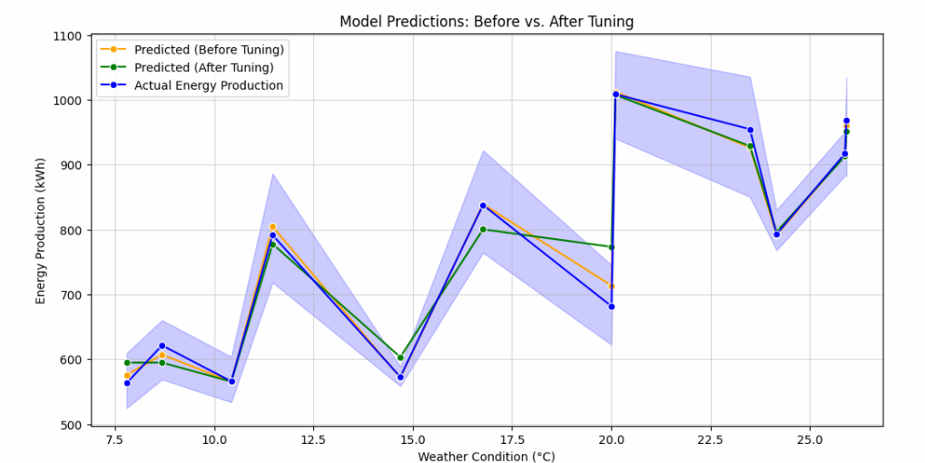
Visualize Tuned Model
What happens here?.
How predictions differ before and after tuning.
Trends over months or specific weather conditions.
note : we draw the monthly energy production vs predictions before and after the tuning step .

Slide 11
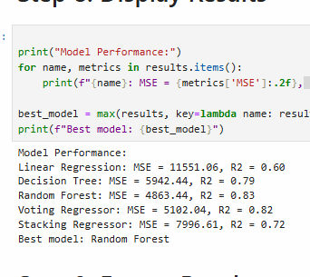
find the best model
display model performance
chose the best model

Slide 12
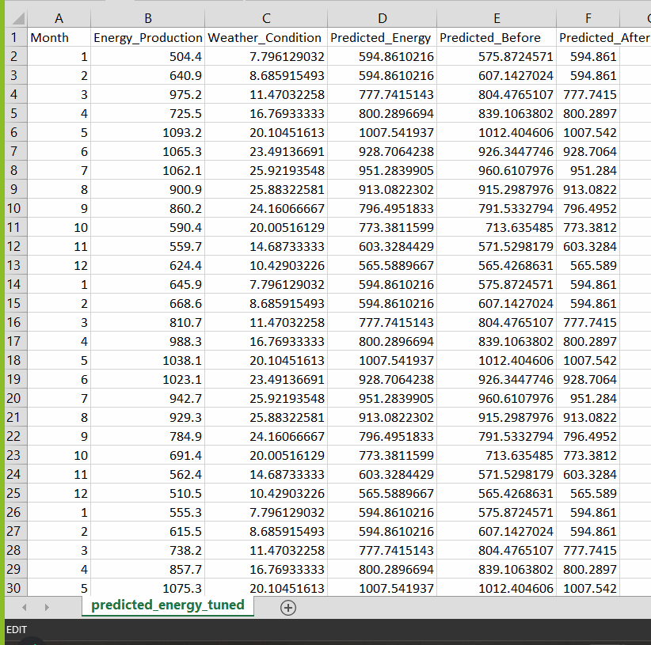
export results
To ensure that the outputs of the project are documented and easily accessible for reporting or future analysis.
Save the tuned model's predictions to a CSV file for future use.
Example:
A CSV containing actual and predicted energy production for each record.
Generate a final summary of results to share or integrate with other systems.

Slide 13


machine learning
Thank's For Watching
worked by:
dia arar 12220363
ali hayek 12220103
musab mashaqi 12010762

